Slide 1
Software Code & Threat Analysis Presentation
Assignment Guidance

Slide 2

Flawfinder
Flawfinder is a simple program that scans C/C++ source code and reports potential security flaws. It can be a useful tool for examining software for vulnerabilities, and it can also serve as a simple introduction to static source code analysis tools more generally. It is designed to be easy to install and use. Flawfinder supports the Common Weakness Enumeration (CWE) and is officially CWE-Compatible.

Slide 3

Image Magick v.7.1.0-27
ImageMagick version 7.1.0-27 is an open-source software suite used for creating, editing, and converting images. It was released on October 2021 and contains various new features, improvements, and bug fixes.

Slide 4
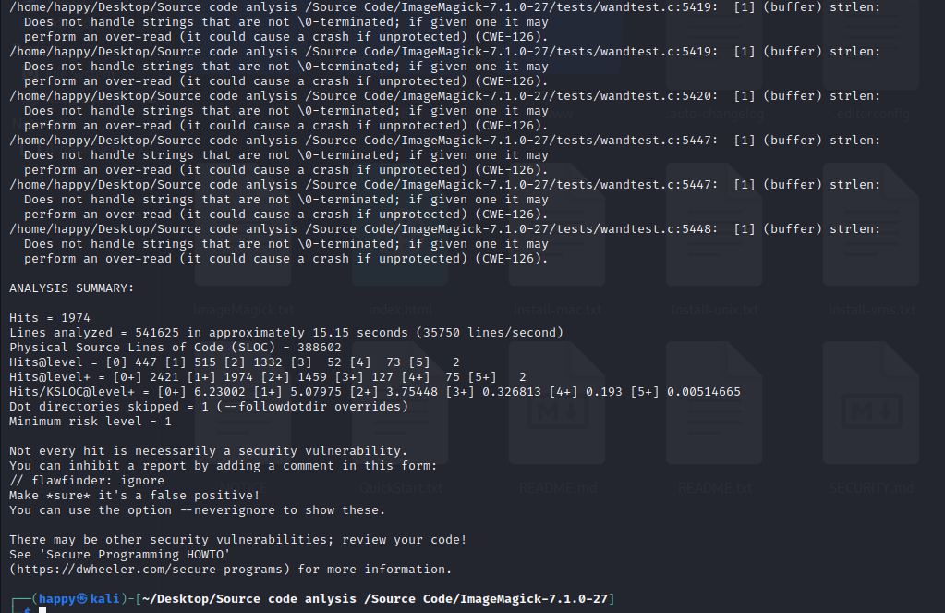
Detail/Discover SW Threats

Slide 5
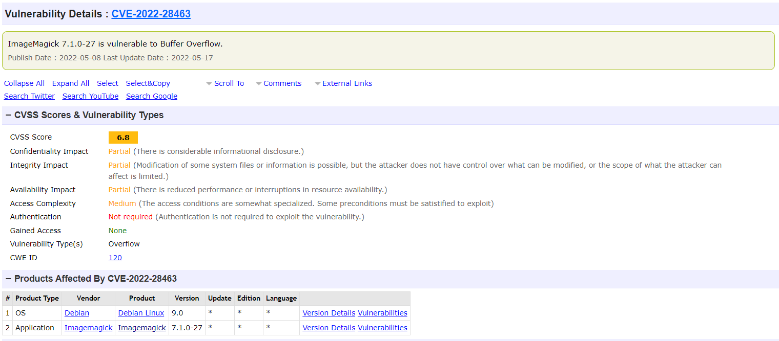
Discuss Mitigations CVE-2022-28463

Slide 6

FFmpeg v.4.4.3
FFmpeg 4.4.3 is a version of the open-source multimedia framework FFmpeg, which was released on August 26, 2021. FFmpeg is used for video and audio encoding, decoding, and transcoding, and it supports a wide range of multimedia formats and codecs.

Slide 7
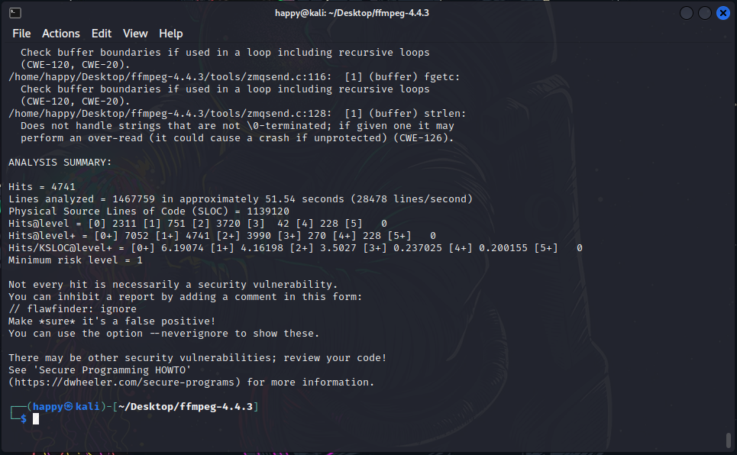
Detail/Discover SW Threats

Slide 8
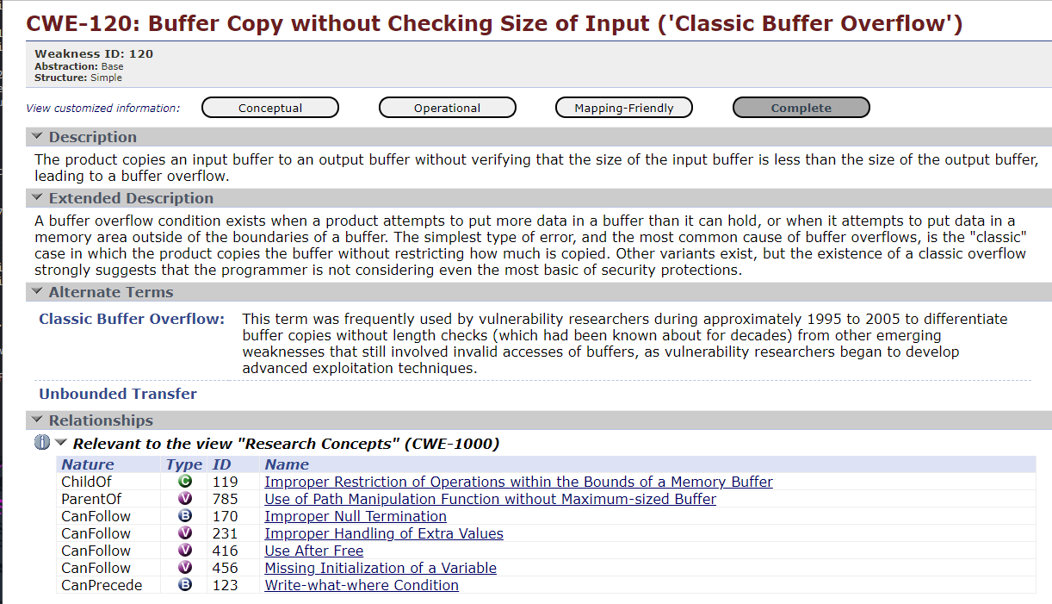
Discuss Mitigations

Slide 9

OWASP Dependency-Check
OWASP Dependency-Check is a software composition analysis (SCA) tool that identifies and reports known vulnerabilities in project dependencies. It can be used to scan Java, .NET, Ruby, Python, and Node.js projects for vulnerabilities in their third-party libraries and frameworks.

Slide 10
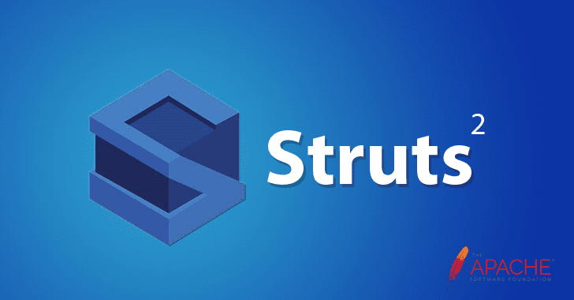
Apache Struts v.2.2.3.1
Apache Struts v.2.2.3.1 is a version of the Apache Struts web application framework that was released in 2011. Struts is a popular framework for building Java web applications, and version 2.2.3.1 was one of the releases in the 2.2.x series of the framework.

Slide 11
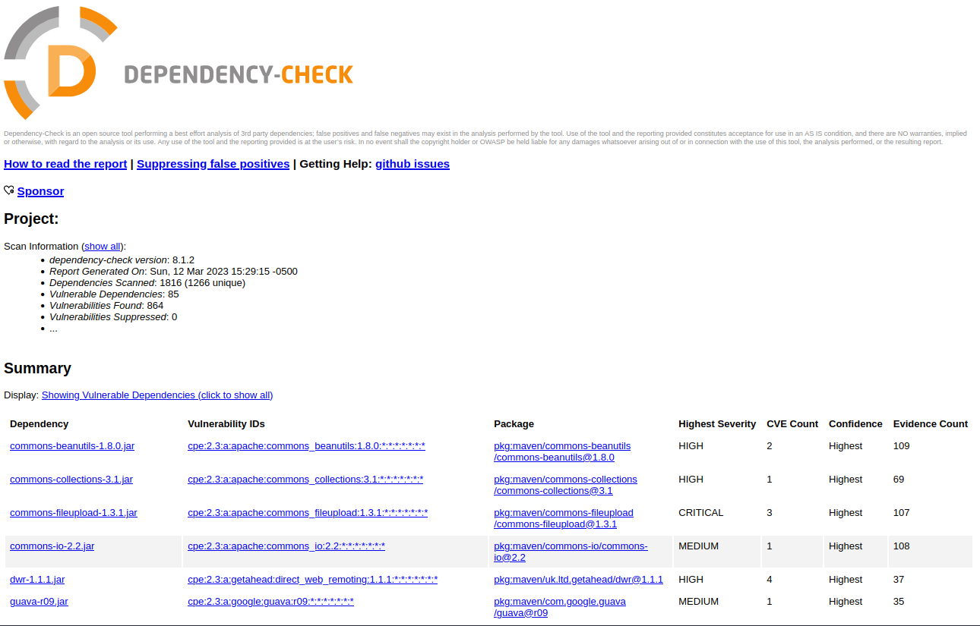
Detail/Discover SW Threats

Slide 12
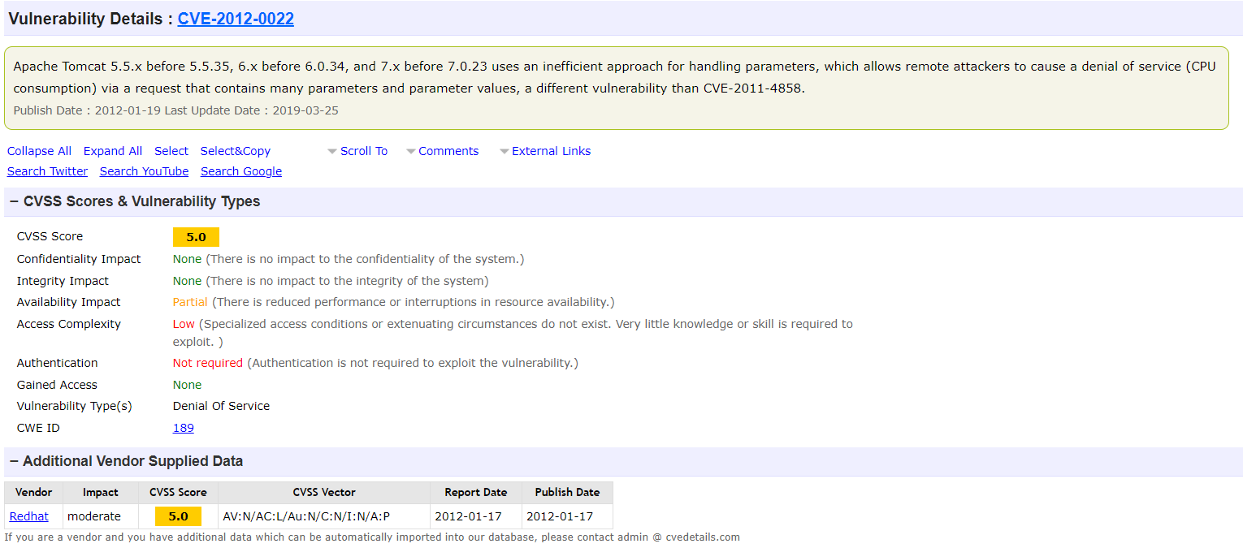
Discuss Mitigations

Slide 13

OpenSSL v.1.0.1
OpenSSL v.1.0.1 is a version of the OpenSSL cryptography library that was released in 2012. OpenSSL is a popular open-source library that provides cryptographic functions to developers, including encryption, decryption, digital signatures, and SSL/TLS communication.

Slide 14
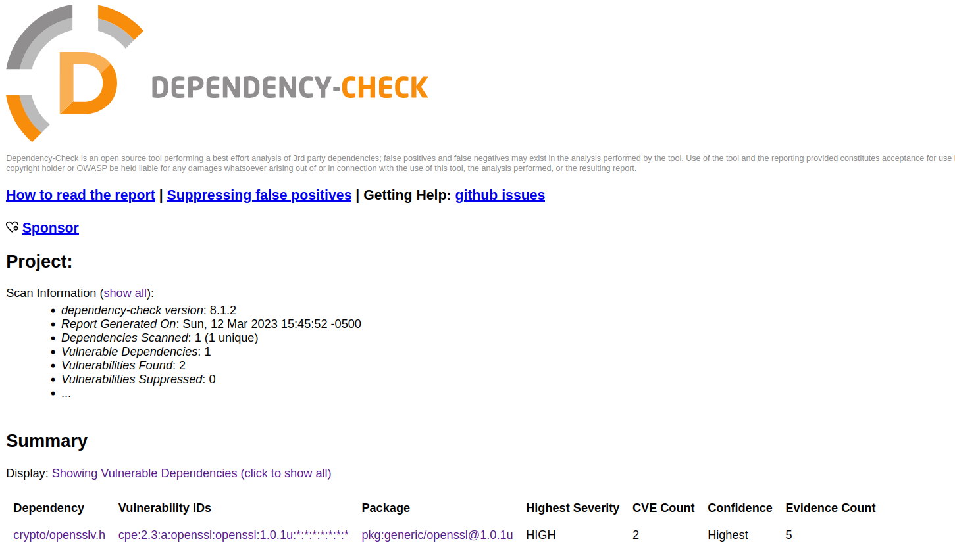
Detail/Discover SW Threats

Slide 15
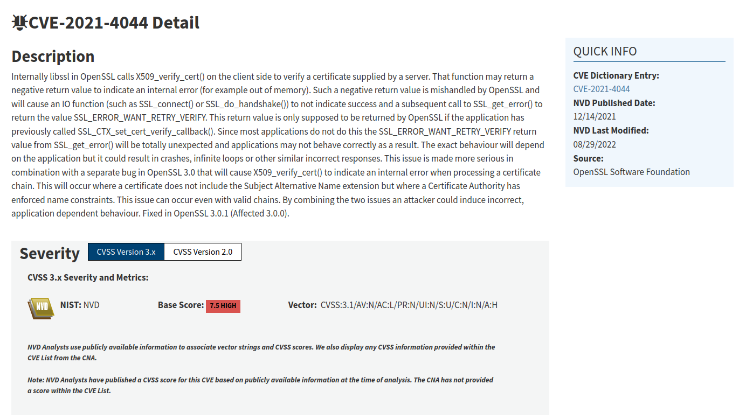
Discuss Mitigations

